Slide 1
Software Engineering
Lecture # 18
Fakhar Lodhi

Slide 2
Recap

Slide 3
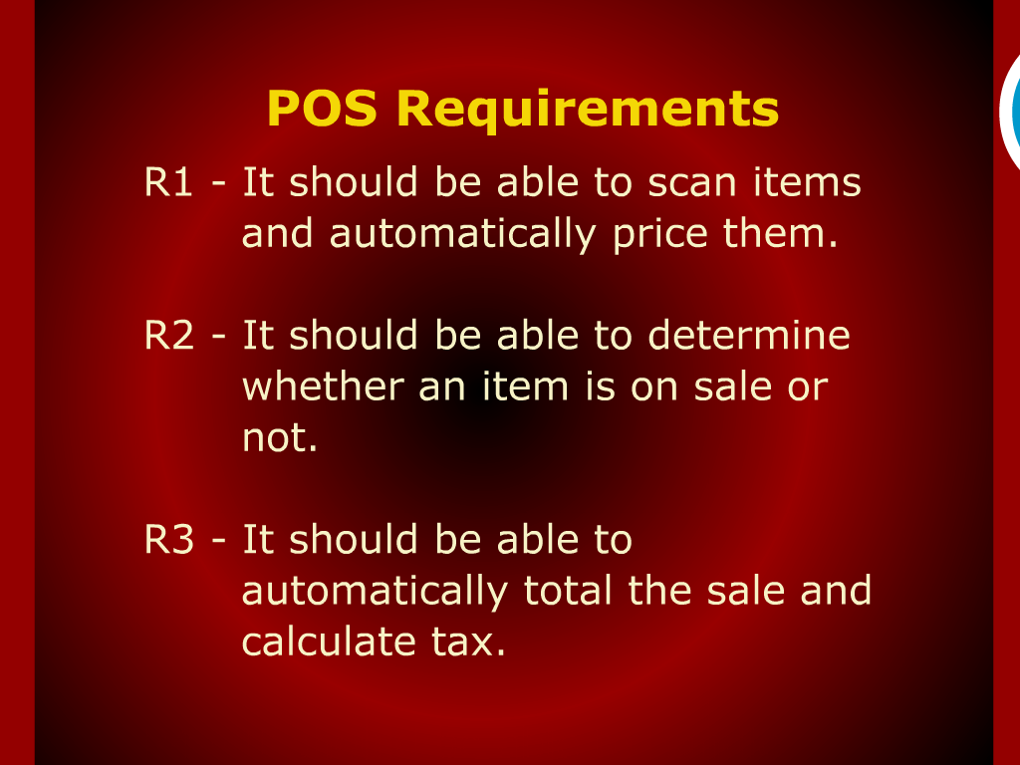
POS Requirements

Slide 4
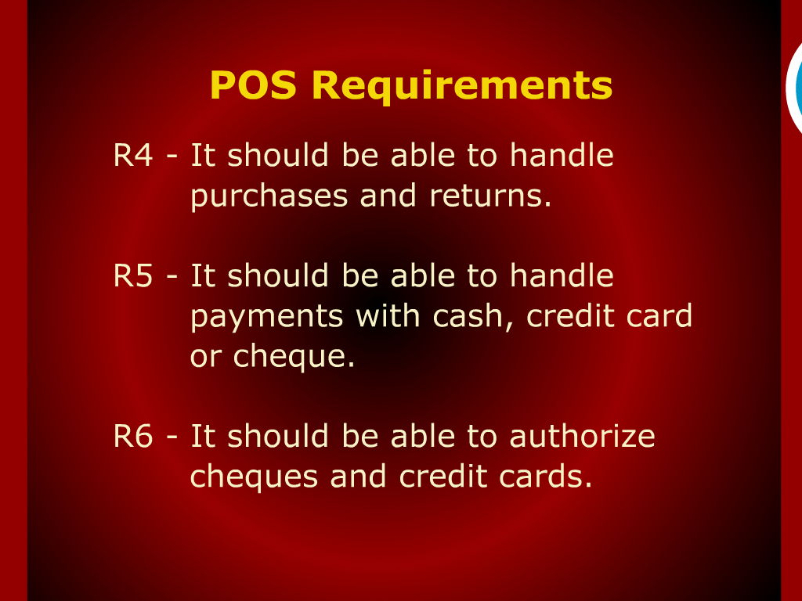

Slide 5
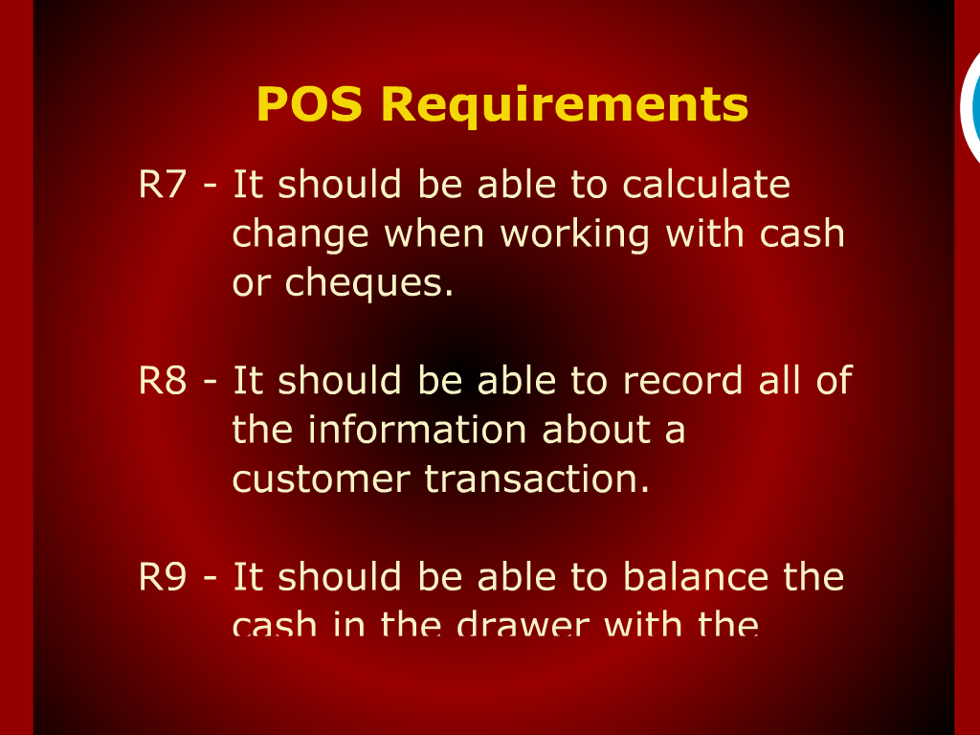
POS Requirements

Slide 6
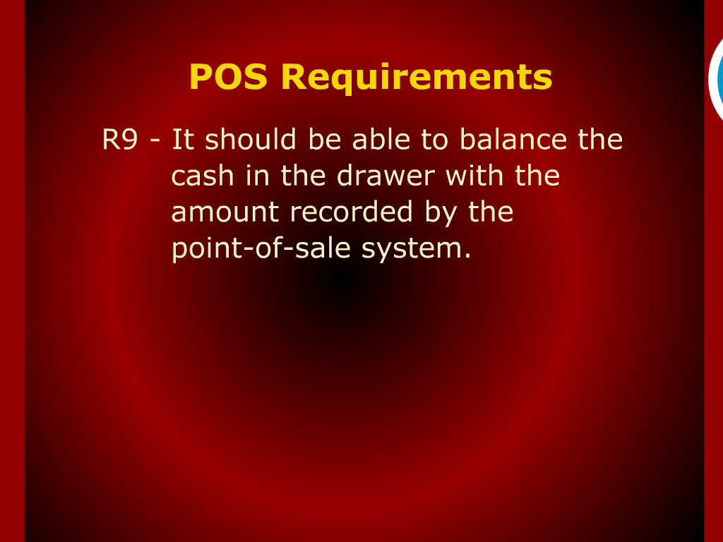
POS Requirements

Slide 7
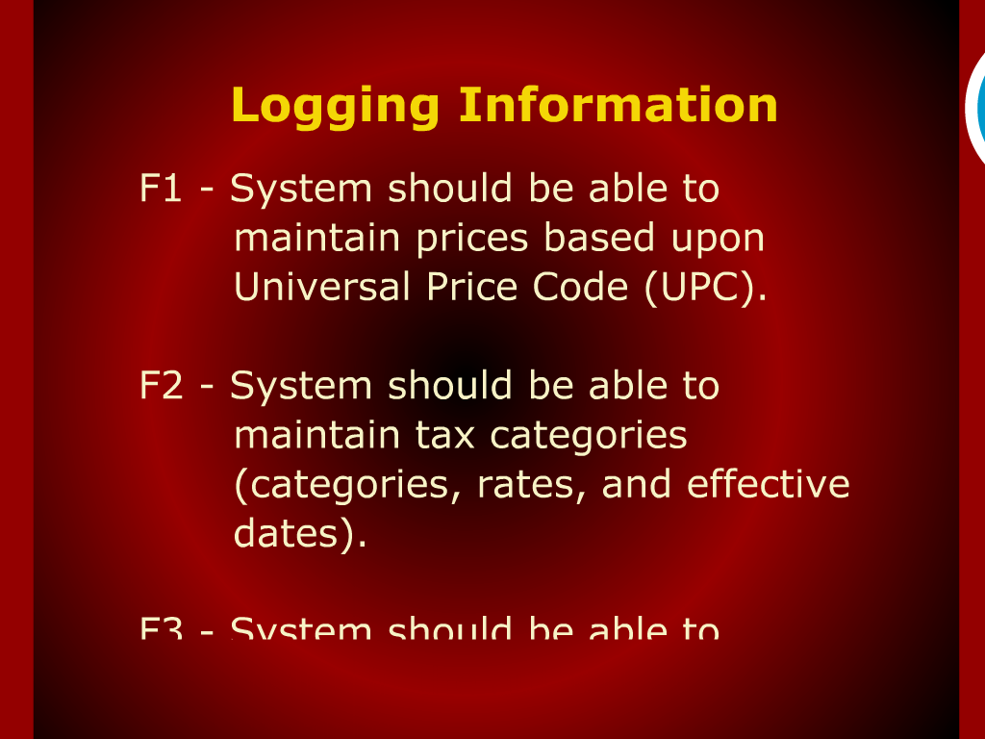
Logging Information

Slide 8
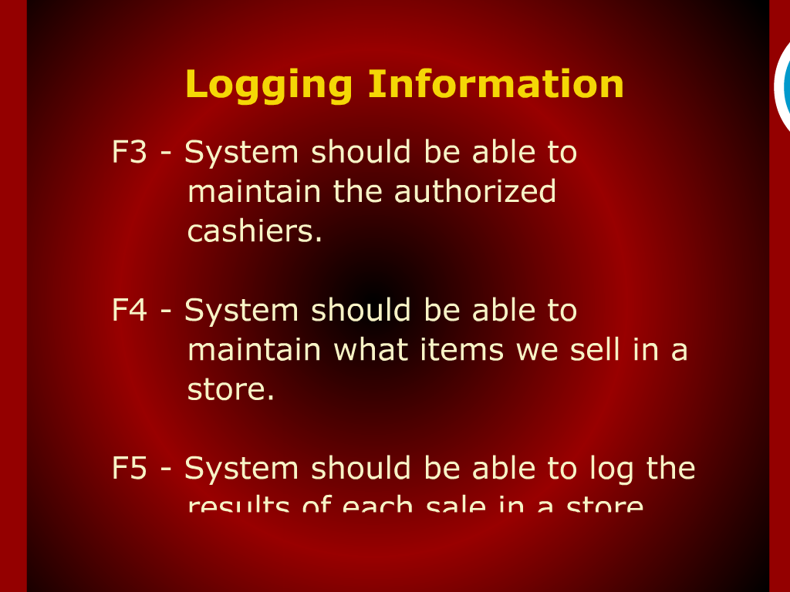
Logging Information

Slide 9
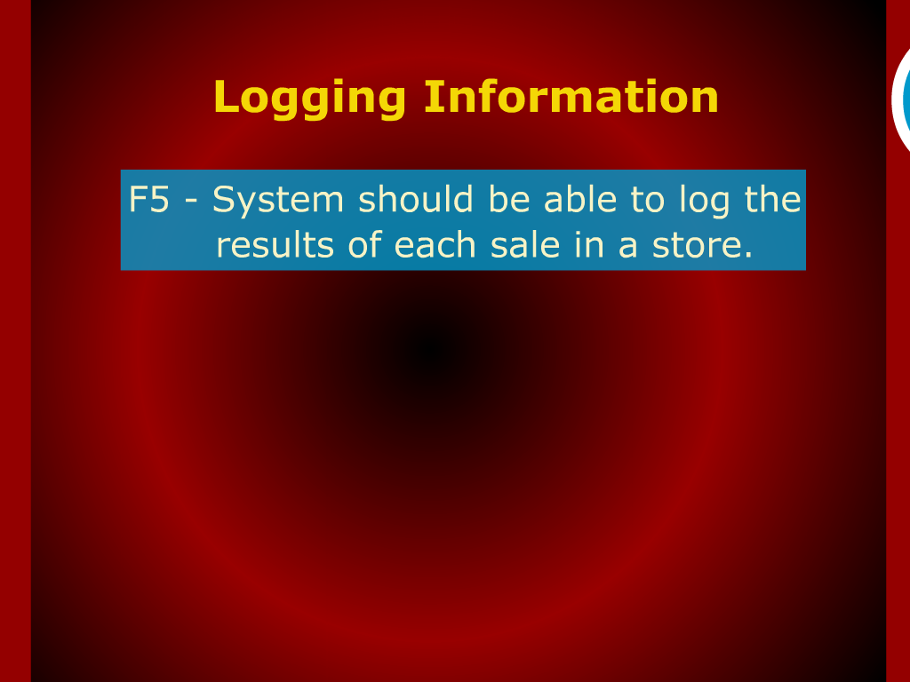
Logging Information

Slide 10
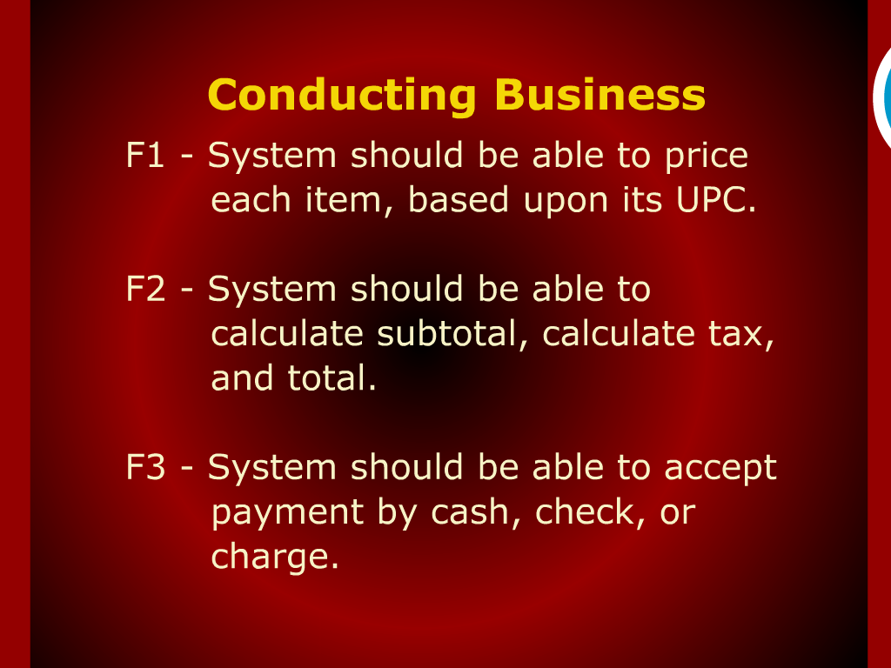
Conducting Business

Slide 11
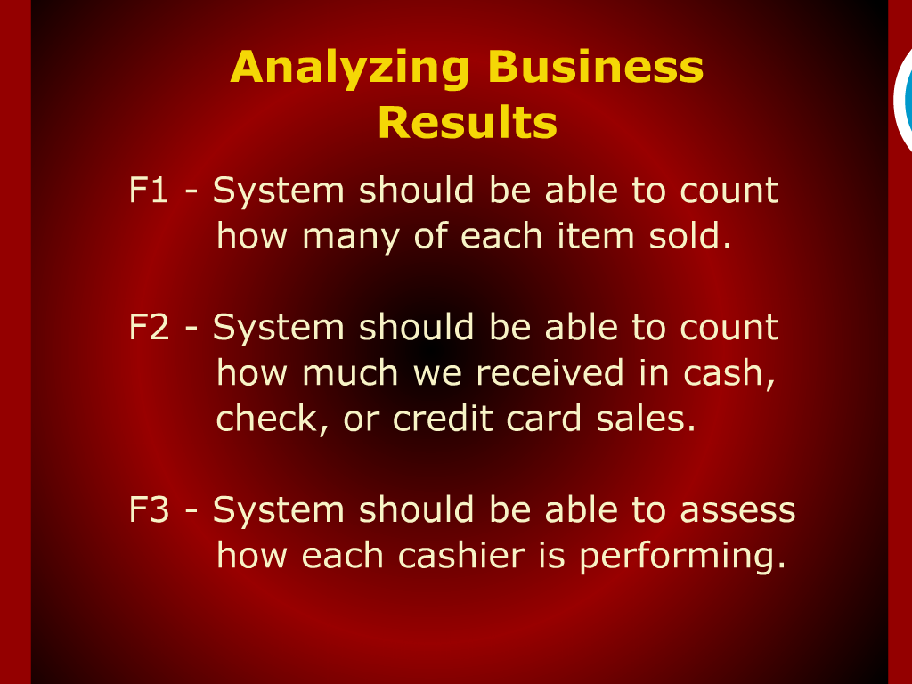
Analyzing Business Results

Slide 12
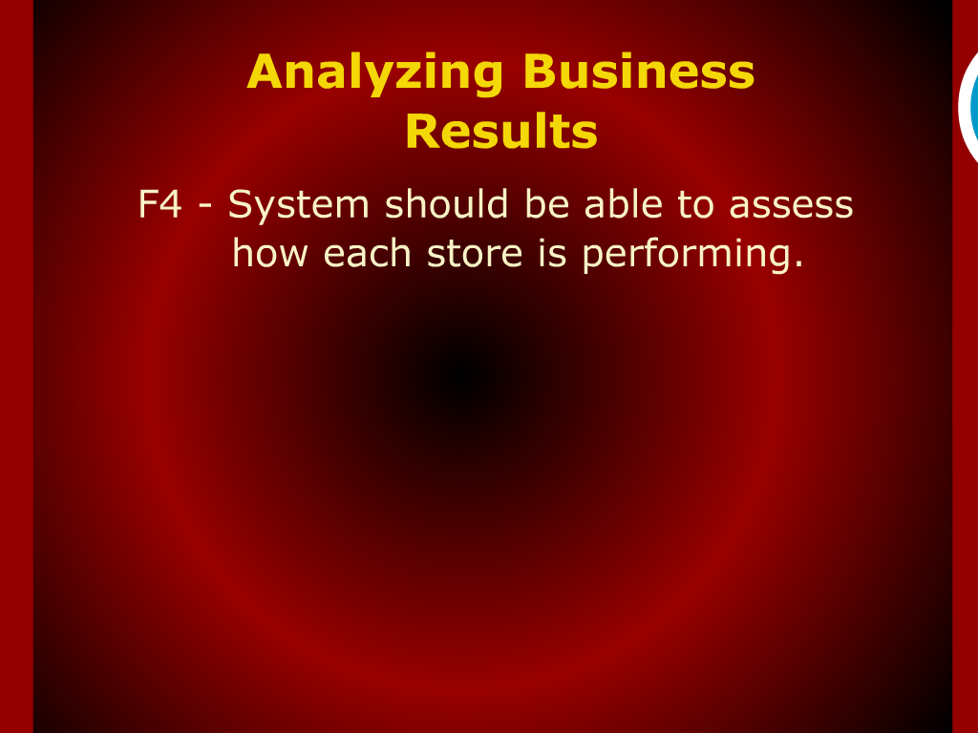
Analyzing Business Results

Slide 13
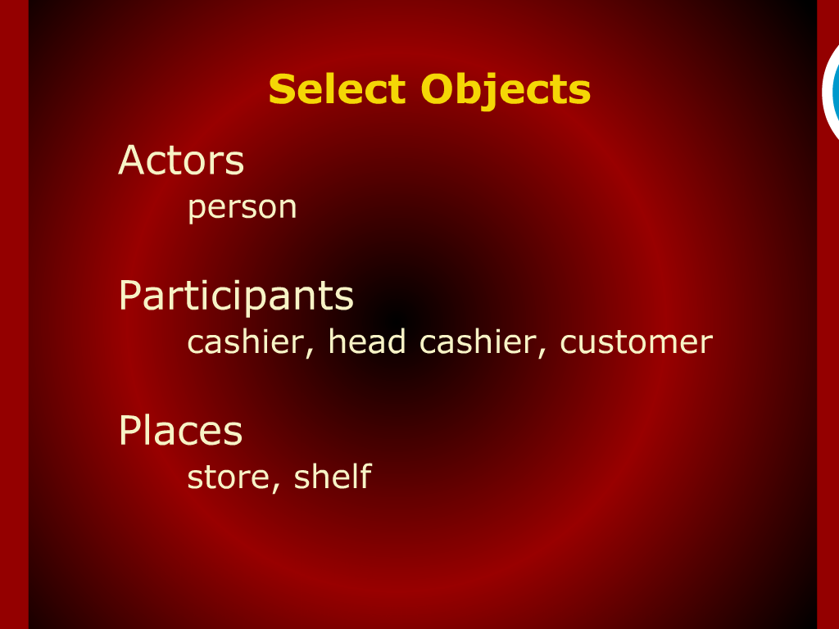
Select Objects

Slide 14
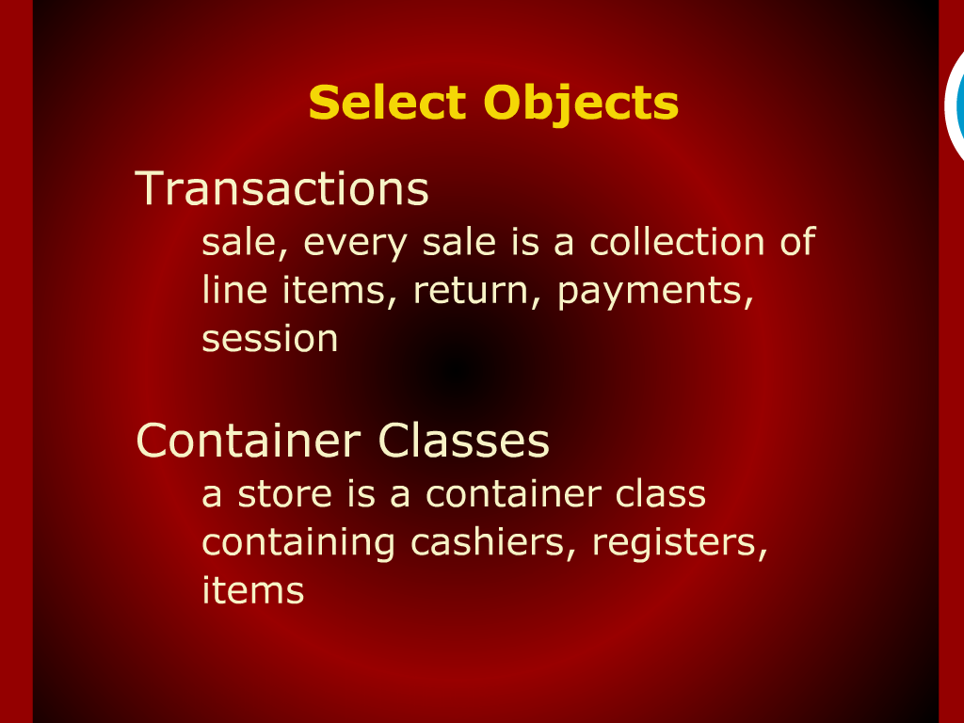
Select Objects

Slide 15
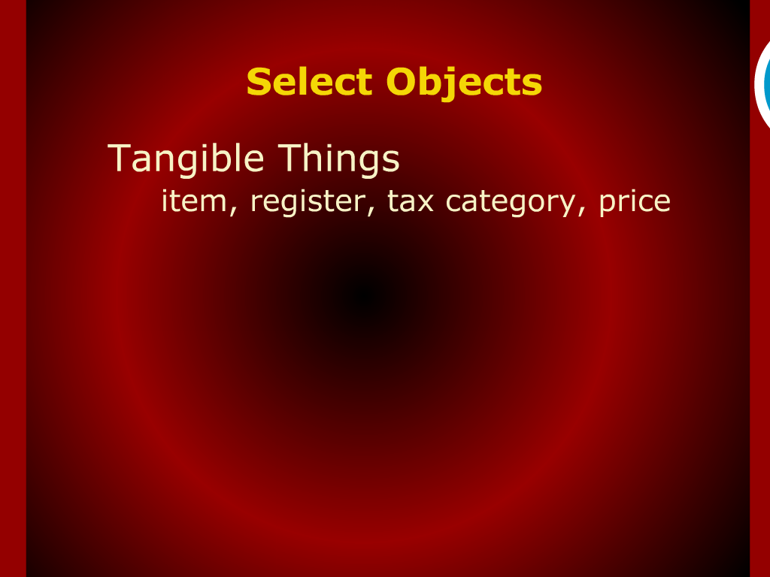
Select Objects

Slide 16
Features for Logging Important Information

Slide 17
System Features

Slide 18
Summary of Today’s Discussion

Slide 19
Features for Conducting Business

Slide 20
Features for Analyzing Business Results

Slide 21
Features for Working with Interacting Systems

